Slide 1


DTS 2019
Internet of Things
28 Data Storage: MongoDB
Abdul Munif
https://github.com/munif/iot-mongodb
digitalent.kominfo.go.id

Slide 2
Topik Bahasan
Motivation
NoSQL
MongoDB
Praktek

Slide 3
Motivation
Problems with SQL
Rigid schema
Not easily scalable (designed for 90’s technology or worse)
Requires unintuitive joins
Perks of mongoDB (No SQL)
Easy interface with common languages (Java, Javascript, PHP, etc.)
DB tech should run anywhere (VM’s, cloud, etc.)
Keeps essential features of RDBMS’s while learning from key-value noSQL systems

Slide 4
NoSQL
Key Value pair
Dynamo DB
Azure Table Storage (ATS )
Document Based
Mongo Db
AmazonSimple DB
[
{
"Name": "Tom",
"Age": 30,
"Role": "Student",
"University": "CU",
}
]
(#key,#value)
(Name, Tom)
(Age,25)
(Role, Student)
(University, CU)

Slide 5
Brief History of NoSQL Databases
1998- Carlo Strozzi use the term NoSQL for his lightweight, open-source relational database
2000- Graph database Neo4j is launched
2004- Google BigTable is launched
2005- CouchDB is launched
2007- The research paper on Amazon Dynamo is released
2008- Facebooks open sources the Cassandra project
2009- The term NoSQL was reintroduced

Slide 6
Features of NoSQL
Non-relational
NoSQL databases never follow the relational model
Never provide tables with flat fixed-column records
Work with self-contained aggregates or BLOBs
Doesn't require object-relational mapping and data normalization
No complex features like query languages, query planners, referential integrity joins, ACID
Schema-free
NoSQL databases are either schema-free or have relaxed schemas
Do not require any sort of definition of the schema of the data
Offers heterogeneous structures of data in the same domain

Slide 7
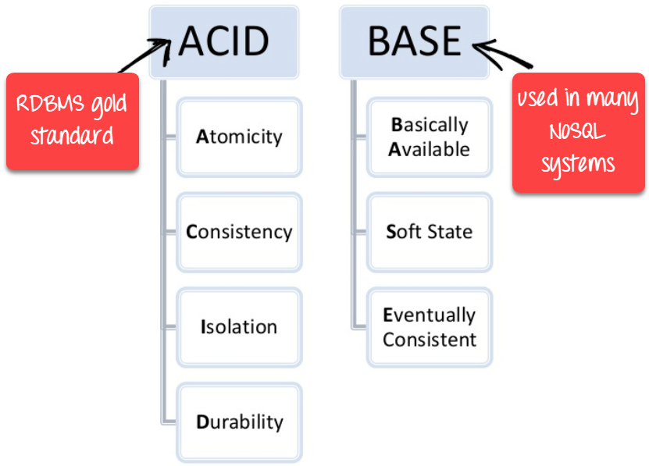
RDBMS vs NoSQL Standard

Slide 8
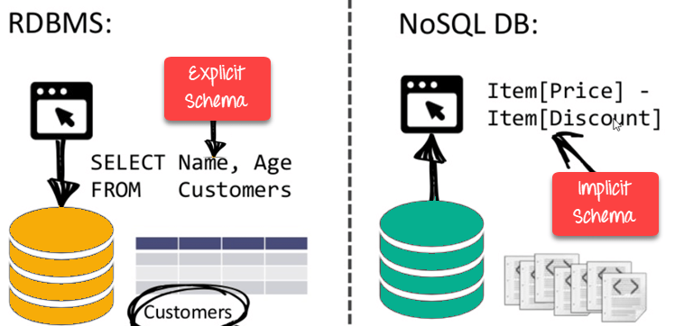
RDBMS vs NoSQL Schema

Slide 9
MongoDB
Document-Based (max 16 MB)
Documents are in BSON (Binary JSON) format, consisting of field-value pairs
Each document stored in a collection
Collections
Have index set in common
Like tables of relational db’s.
Documents do not have to have uniform structure

Slide 10
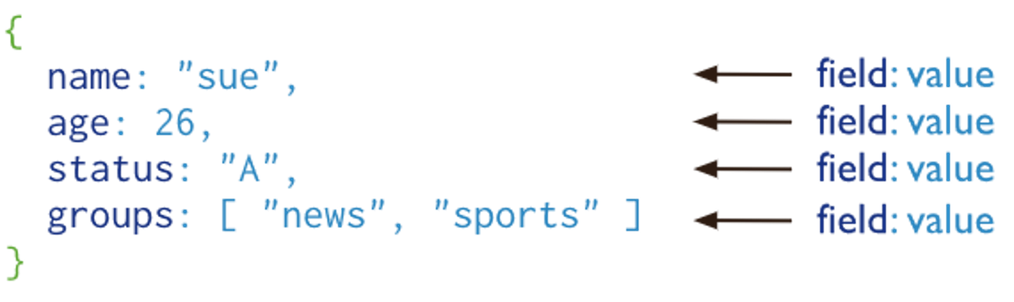
MongoDB
A record in MongoDB is a document, which is a data structure composed of field and value pairs. MongoDB documents are similar to JSON objects. The values of fields may include other documents, arrays, and arrays of documents.

Slide 11
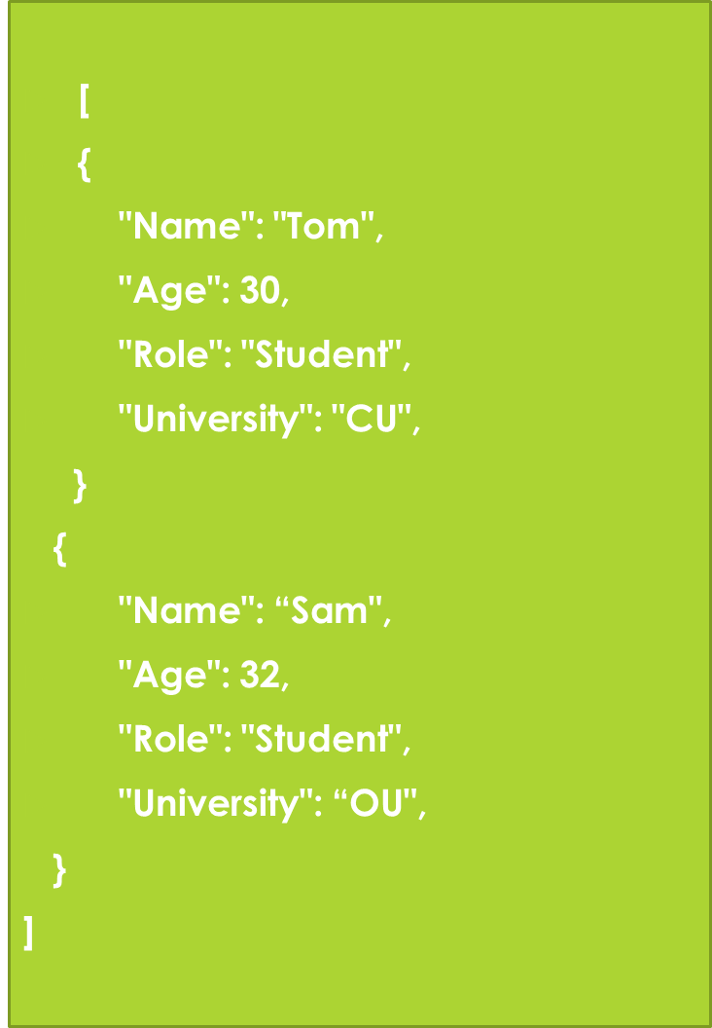
Document(JSON) structure
The document has simple structure and very easy to understand the content
JSON is smaller, faster and lightweight compared to XML.
For data delivery between servers and browsers, JSON is a better choice
Easy in parsing, processing, validating in all languages
JSON can be mapped more easily into object oriented system.

Slide 12
MongoDB BSON
MongoDB represents JSON documents in binary-encoded format called BSON behind the scenes. BSON extends the JSON model to provide additional data types, ordered fields, and to be efficient for encoding and decoding within different languages

Slide 13
BSON
“Binary JSON”
Binary-encoded serialization of JSON-like docs
Also allows “referencing”
Embedded structure reduces need for joins
Goals
Lightweight
Traversable
Efficient (decoding and encoding)

Slide 14
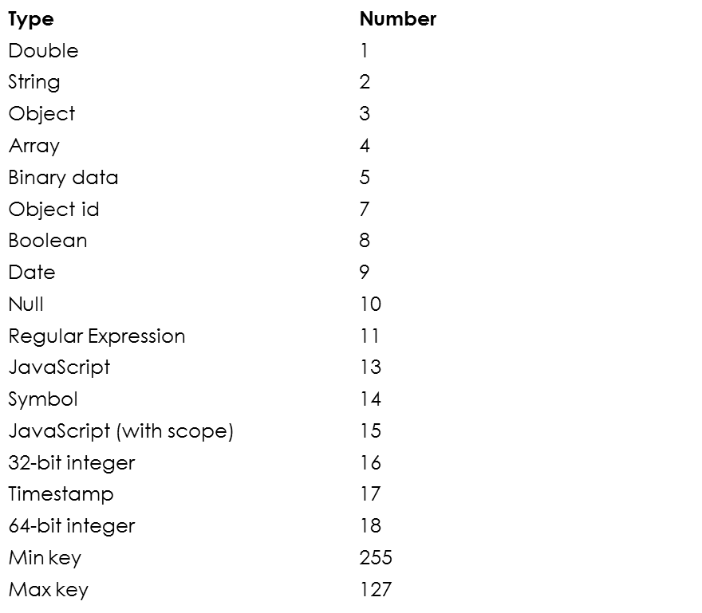
BSON Types

Slide 15
Why Use MongoDB
Document-oriented – Since MongoDB is a NoSQL type database, instead of having data in a relational type format, it stores the data in documents. This makes MongoDB very flexible and adaptable to real business world situation and requirements.
Ad hoc queries - MongoDB supports searching by field, range queries, and regular expression searches. Queries can be made to return specific fields within documents.
Indexing - Indexes can be created to improve the performance of searches within MongoDB. Any field in a MongoDB document can be indexed.
Replication - MongoDB can provide high availability with replica sets. A replica set consists of two or more mongo DB instances. Each replica set member may act in the role of the primary or secondary replica at any time. The primary replica is the main server which interacts with the client and performs all the read/write operations. The Secondary replicas maintain a copy of the data of the primary using built-in replication. When a primary replica fails, the replica set automatically switches over to the secondary and then it becomes the primary server.
Load balancing - MongoDB uses the concept of sharding to scale horizontally by splitting data across multiple MongoDB instances. MongoDB can run over multiple servers, balancing the load and/or duplicating data to keep the system up and running in case of hardware failure.

Slide 16
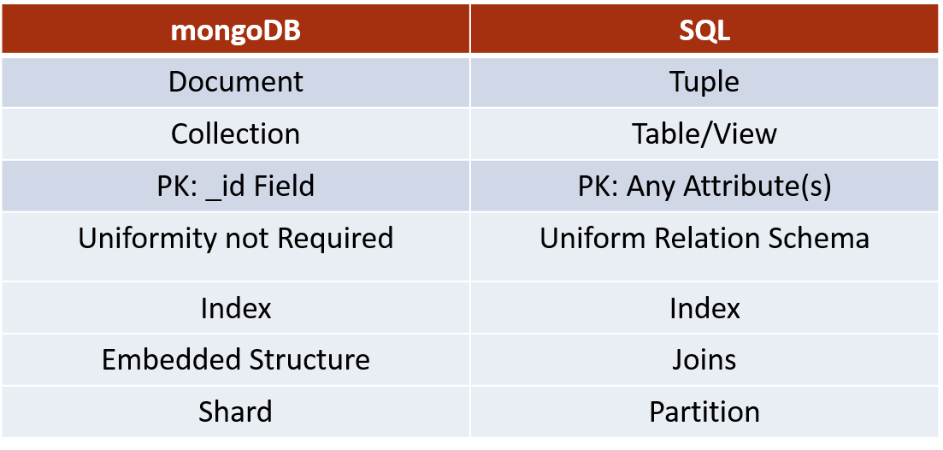
mongoDB vs. SQL

Slide 17
Key Components of MongoDB Architecture
_id – This is a field required in every MongoDB document. The _id field represents a unique value in the MongoDB document. The _id field is like the document's primary key. If you create a new document without an _id field, MongoDB will automatically create the field. So for example, if we see the example of the above customer table, Mongo DB will add a 24 digit unique identifier to each document in the collection.
Collection – This is a grouping of MongoDB documents. A collection is the equivalent of a table which is created in any other RDMS such as Oracle or MS SQL. A collection exists within a single database. As seen from the introduction collections don't enforce any sort of structure.
Cursor – This is a pointer to the result set of a query. Clients can iterate through a cursor to retrieve results.
Database – This is a container for collections like in RDMS wherein it is a container for tables. Each database gets its own set of files on the file system. A MongoDB server can store multiple databases.
Document - A record in a MongoDB collection is basically called a document. The document, in turn, will consist of field name and values.
Field - A name-value pair in a document. A document has zero or more fields. Fields are analogous to columns in relational databases. The following diagram shows an example of Fields with Key value pairs. So in the example below CustomerID and 11 is one of the key value pair's defined in the document.
JSON – This is known as JavaScript Object Notation. This is a human-readable, plain text format for expressing structured data. JSON is currently supported in many programming languages.

Slide 18
MongoDB Data Shell
To check which db you’re using db
Show all databases show dbs
Switch db’s/make a new one use <name>
See what collections exist show collections

Slide 19
MongoDB insert
To insert documents into a collection/make a new collection:
db.<collection>.insert(<document>)
<=>
INSERT INTO <table>
VALUES(<attributevalues>);

Slide 20
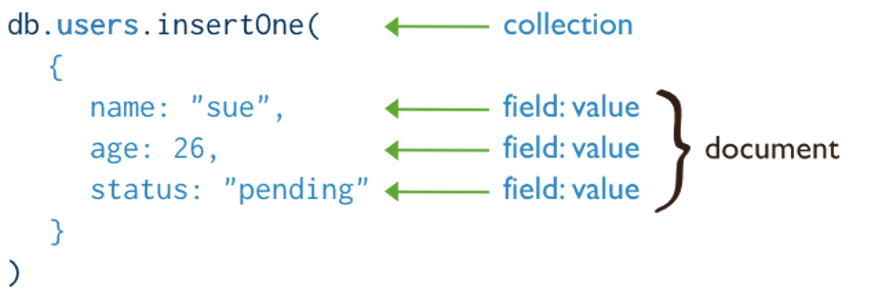
Mongo DB Create
MongoDB provides the following methods to insert documents into a collection:
db.collection.insertOne() New in version 3.2
db.collection.insertMany()
In MongoDB, insert operations target a single collection. All write operations in MongoDB are atomic on the level of a single document.

Slide 21
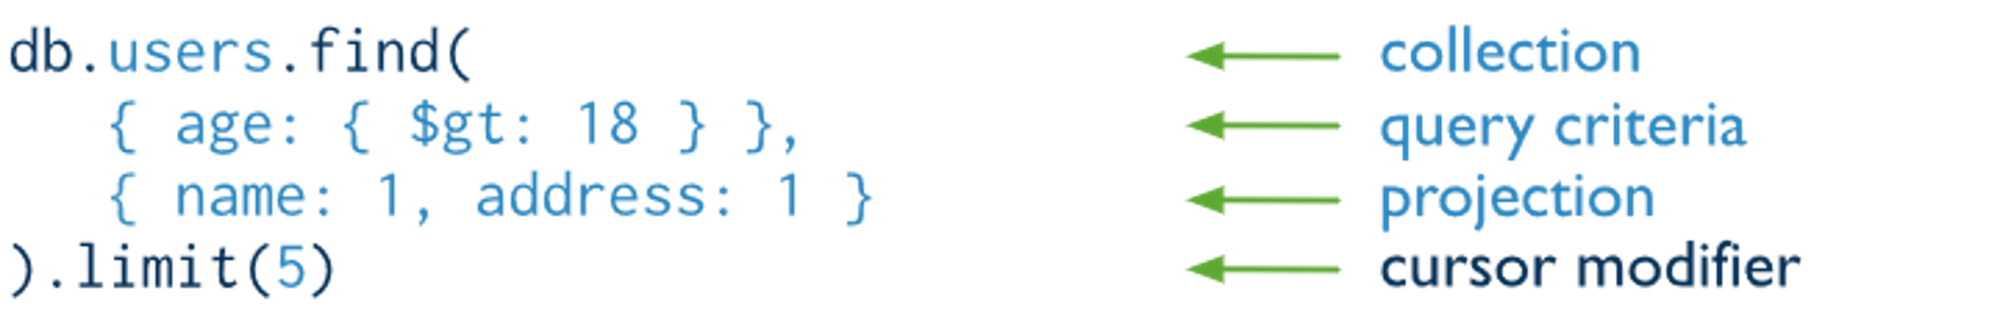
MongoDB Read
Read operations retrieves documents from a collection; i.e. queries a collection for documents. MongoDB provides the following methods to read documents from a collection:
db.collection.find()
You can specify query filters or criteria that identify the documents to return.

Slide 22
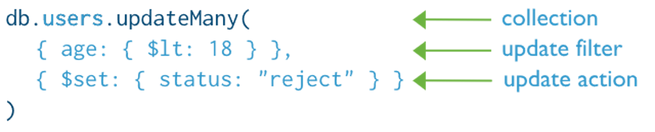
MongoDB Update

Slide 23
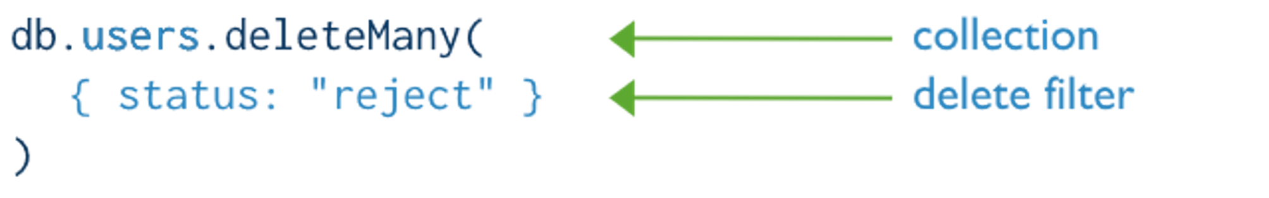
MongoDB Delete
Delete operations remove documents from a collection. MongoDB provides the following methods to delete documents of a collection:
db.collection.deleteOne() New in version 3.2
db.collection.deleteMany()
In MongoDB, delete operations target a single collection. All write operations in MongoDB are atomic on the level of a single document.
You can specify criteria, or filters, that identify the documents to remove. These filters use the same syntax as read operations.

Slide 24
SQL vs MongoDB Schema
SQL Schema Statements | MongoDB Schema Statements
CREATE TABLE people ( id MEDIUMINT NOT NULL AUTO_INCREMENT, user_id Varchar(30), age Number, status char(1), PRIMARY KEY (id) ) | Implicitly created on first insertOne() or insertMany() operation. The primary key _id is automatically added if _id field is not specified. db.people.insertOne( { user_id: "abc123", age: 55, status: "A" } ) However, you can also explicitly create a collection: db.createCollection("people")

Slide 25
SQL vs MongoDB Index and Drop
CREATE INDEX idx_user_id_asc ON people(user_id) | db.people.createIndex( { user_id: 1 } )
CREATE INDEX idx_user_id_asc_age_desc ON people(user_id, age DESC) | db.people.createIndex( { user_id: 1, age: -1 } )
DROP TABLE people | db.people.drop()

Slide 26
MongoDB The find() Method
To query data from MongoDB collection, you need to use MongoDB's find() method.
The basic syntax of find() method is as follows −
“db.COLLECTION_NAME.find()”
find() method will display all the documents in a non-structured way.
To display the results in a formatted way, you can use pretty() method.
“db.mycol.find().pretty() “

Slide 27
MongoDB The remove() Method
MongoDB's remove() method is used to remove a document from the collection. remove() method accepts two parameters. One is deletion criteria and second is justOne flag.
deletion criteria − (Optional) deletion criteria according to documents will be removed.
justOne − (Optional) if set to true or 1, then remove only one document.

Slide 28
MongoDB Delete
Remove all records where field = value
db.<collection>.remove({<field>:<value>})
DELETE FROM <table>
WHERE <field> = <value>;
As above, but only remove first document
db.<collection>.remove({<field>:<value>}, true)

Slide 29
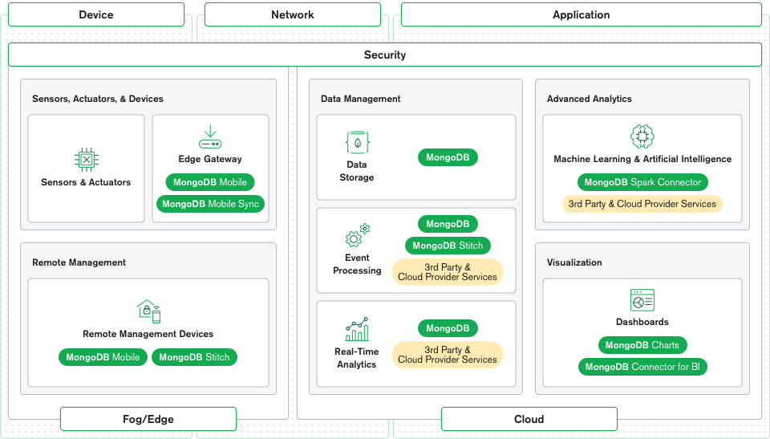
MongoDB’s IoT Reference Architecture

Slide 30
Praktek
MongoDB server
MongoDB Compass

Slide 31
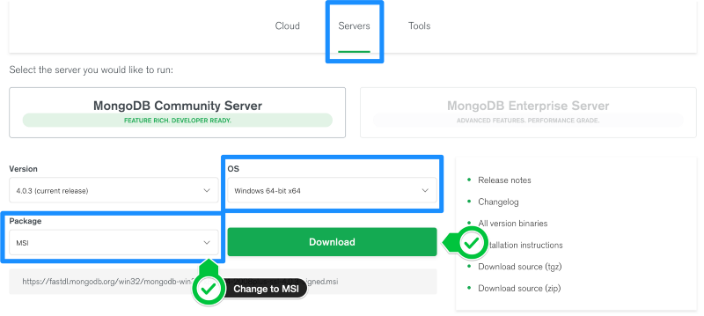
Download the MongoDB MSI Installer Package

Slide 32
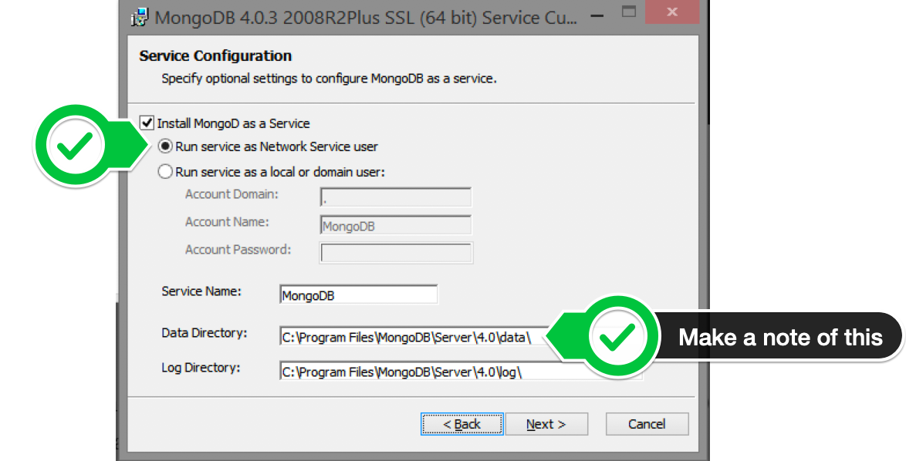
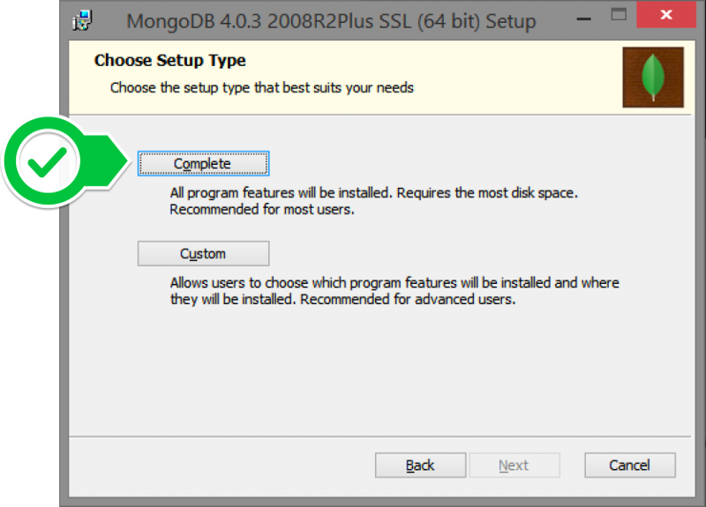
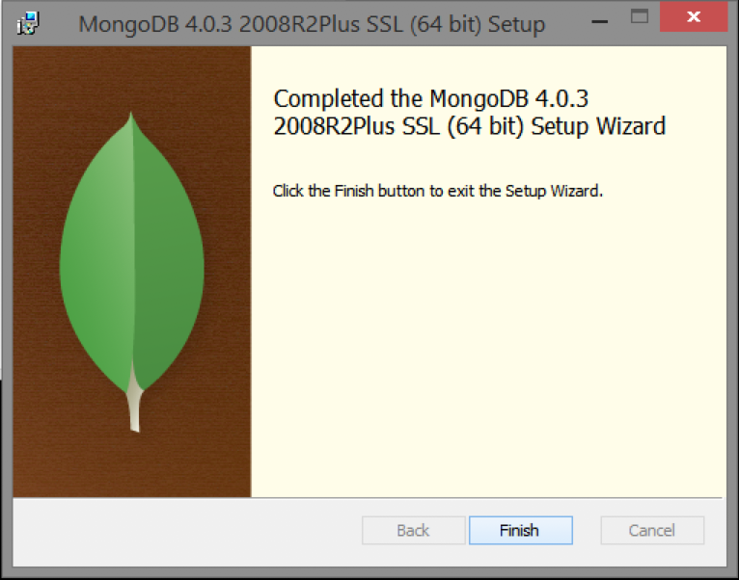
Install MongoDB with the Installation Wizard

Slide 33
Jalankan MongoDB pada Terminal
Masuk ke folder “bin” pada MongoDB yang sudah di install sebelumnya melalui CMD:
> cd “C:\Program Files\MongoDB\Server\4.0\bin”
Jalankan MongoDB dengan perintah berikut:
> mongo

Slide 34
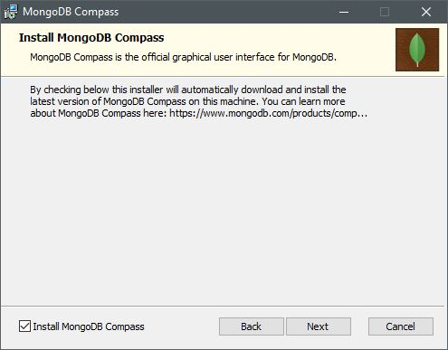
Install MongoDB Compass
Membantu mengatur database pada mongodb agar lebih mudah.

Slide 35
Mongo console
Db.help()
Db.stat()
Db.’db’.save ({})
Db.test. save({a:1})
Db.’db’.find()
Db.test.find()

Slide 36
Buat Database
Buat database gunakan perintah:
> use library
Cek database:
> db

Slide 37
Buat Collection
Buat collection:
> db.createCollections(“book”)
> db.createCollections(“article”)
> db.createCollections(“journal”)
Cek database:
> db
Lihat collection
> show collections

Slide 38
Hapus Collection
Hapus collection
> db.book.drop()
> db.article.drop()

Slide 39
Hapus Database
Cek database:
> db
Hapus database
> db.dropDatabase()

Slide 40
MongoDB Atlas
The flexibility and scalability of a document database with the ease and automation of a fully managed service on your preferred cloud.
https://docs.atlas.mongodb.com/getting-started/?_ga=2.62498092.1883022073.1561075212-443738883.1561075212
https://www.guru99.com/mongodb-atlas-cloud.html
https://docs.aws.amazon.com/quickstart/latest/mongodb/overview.html

Slide 41
Connect dari PHP

Slide 42
Persiapan
Install MongoDB driver
Install composer for PHP

Slide 43
Install MongoDB Driver
Create info.php
<?php
phpinfo();
>?
Cek PHP
Versi: 7.2.4
Architecture: x86
Thread Safety: enabled

Slide 44
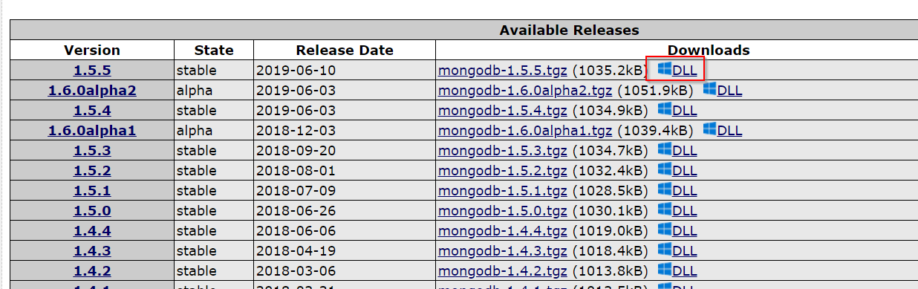
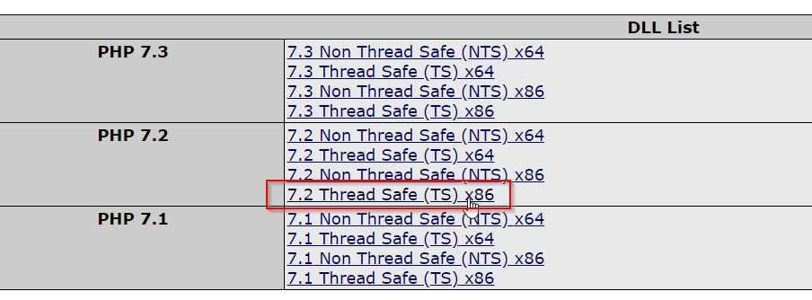
Install MongoDB Driver
Download driver sesuai dengan versi PHP (https://pecl.php.net/package/mongodb)

Slide 45
Install MongoDB Driver
Extract php_mongodb.dll dan copy ke folder xampp\php\ext
Edit file php.ini di folder xampp\php
Tambahkan baris kode berikut
extension=php_mongodb.dll

Slide 46
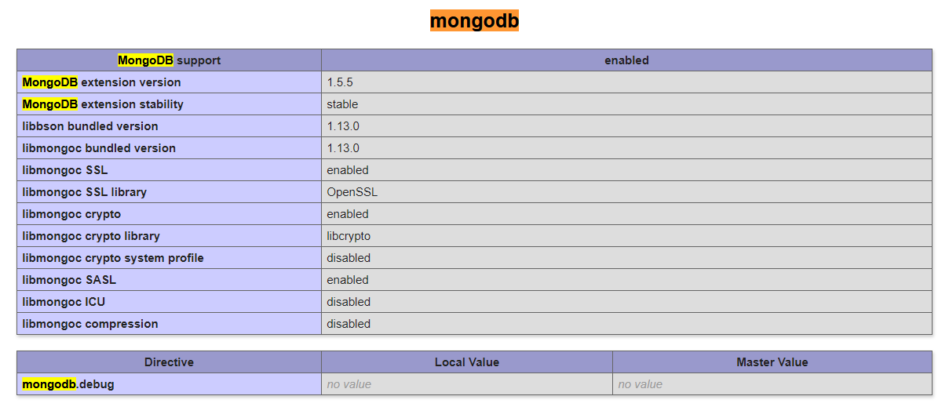
Install MongoDB Driver
Restart Apache
Cek file info.php di browser kembali. Pastikan extension MongoDB telah aktif

Slide 47
Install composer
https://getcomposer.org/

Slide 48
Create Project
Buat folder baru di xampp\htdocs
Jalankan command prompt dan masuk ke folder tersebut
Install MongoDB Library
composer require mongodb/mongodb

Slide 49





IKUTI KAMI
digitalent.kominfo
digitalent.kominfo
DTS_kominfo
Digital Talent Scholarship 2019
Pusat Pengembangan Profesi dan Sertifikasi
Badan Penelitian dan Pengembangan SDM
Kementerian Komunikasi dan Informatika
Jl. Medan Merdeka Barat No. 9
(Gd. Belakang Lt. 4 - 5)
Jakarta Pusat, 10110
digitalent.kominfo.go.id

